Slide 1

An E-commerce website
for student accessories
BATCH : 12
20R21A05F1 : AJITESH
20R21A05H2 : SHAIK AHMED
20R21A05F9 : HITESH
21R25A0517 : ABHILASH

Slide 2

Contents:
Introduction
Process of E-commerce
Features
Advantages and Disadvantages
Conclusion

Slide 3
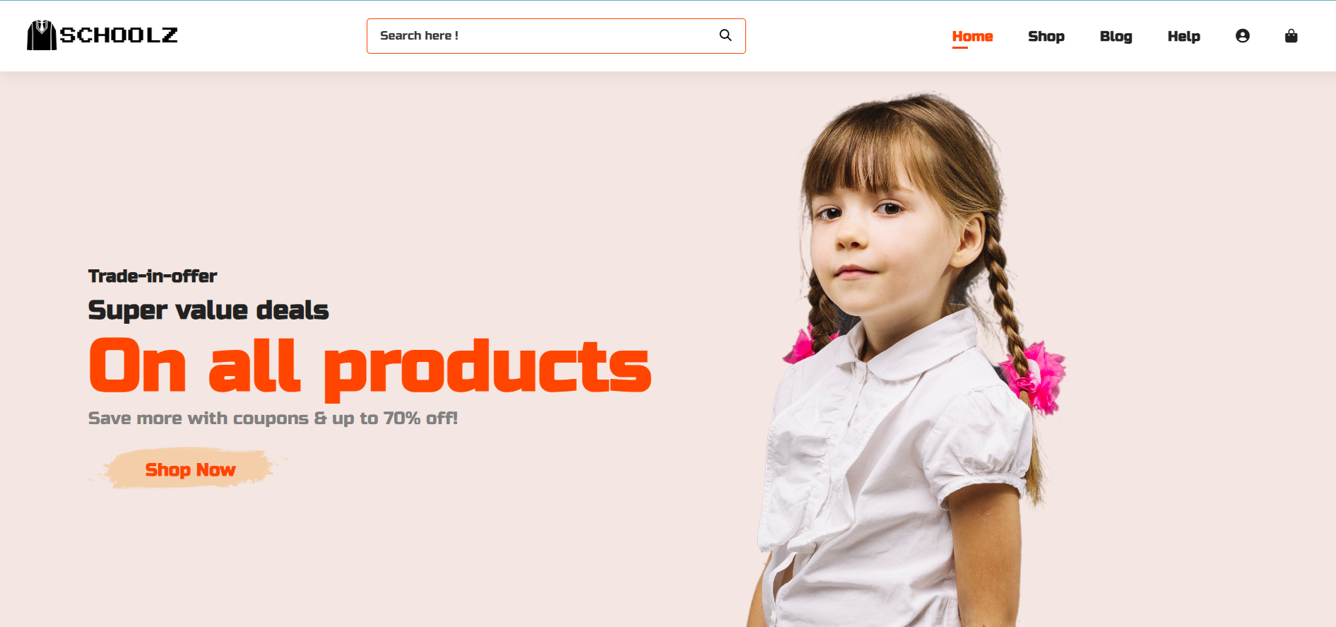
ABSTRACT
The main aim of this project is to preserve paddy from unseasonal rains and heavy winds during crop drying period by using a simple IOT device.
This device can also provide certain useful information about paddy such as Humidity, Temperature.

Slide 4

What is E-Commerce ?
Commonly known as Electronic Marketing
“ It consist of buying and selling goods and services over an electronic systems such as the internet and other computer networks. “

Slide 5
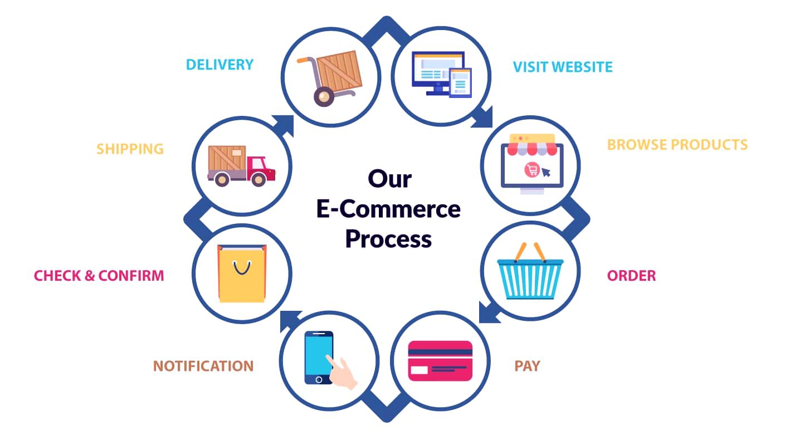
The Process of E-commerce

Slide 6
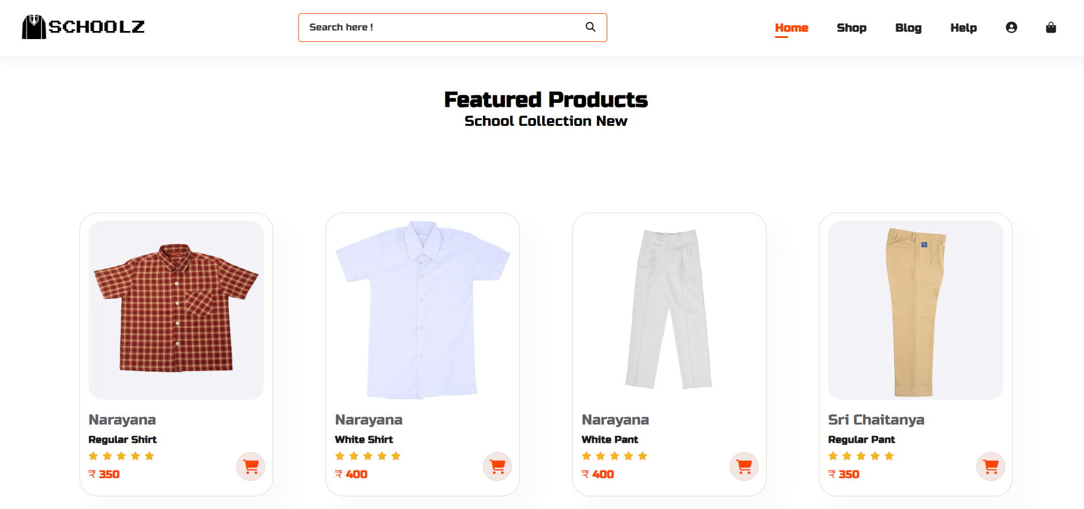
PROPOSED SYSTEM
Our system is an E - commerce website from where people can buy products online
Admin monitors the activity of the users and checks the transactions.

Slide 7
Features:
Home page
Shop page
Help page
Login or signup
Cart

Slide 8
Languages
Tools
HTML 5
CSS 3
BOOTSTRAP
PHP
MYSQL
Adobe Photoshop
Firebase
Visual Studio Code

Slide 9
Advantages
Faster buying and 24/ 7 buying
More reach to customers, there is no theoretical geographic limitations.
Low operational costs and better quality of services.
No need of physical company set-ups.
Easy to start and manage a business.

Slide 10
Disadvantages
Unable to examine products personally
Not everyone is connected to the Internet
Mechanical failures can cause unpredictable effects on the total processes

Slide 11
Screen Shots

Slide 12
CONCLUSION
We are thinking of dome modifications and adding some advanced new features in out system. Some of them are –
# App
# Users can signup / login using their social media account such as Facebook, Google etc.

Slide 13


Slide 14
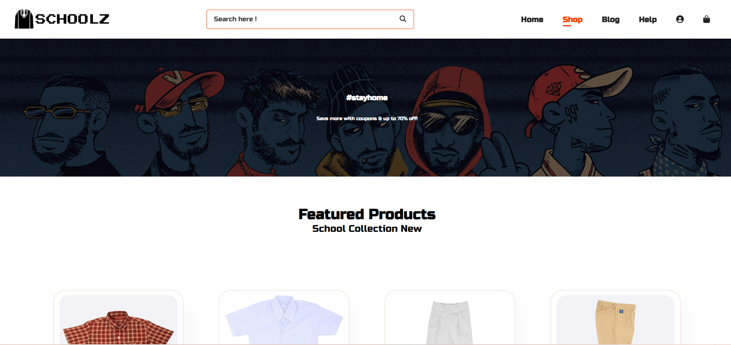

Slide 15
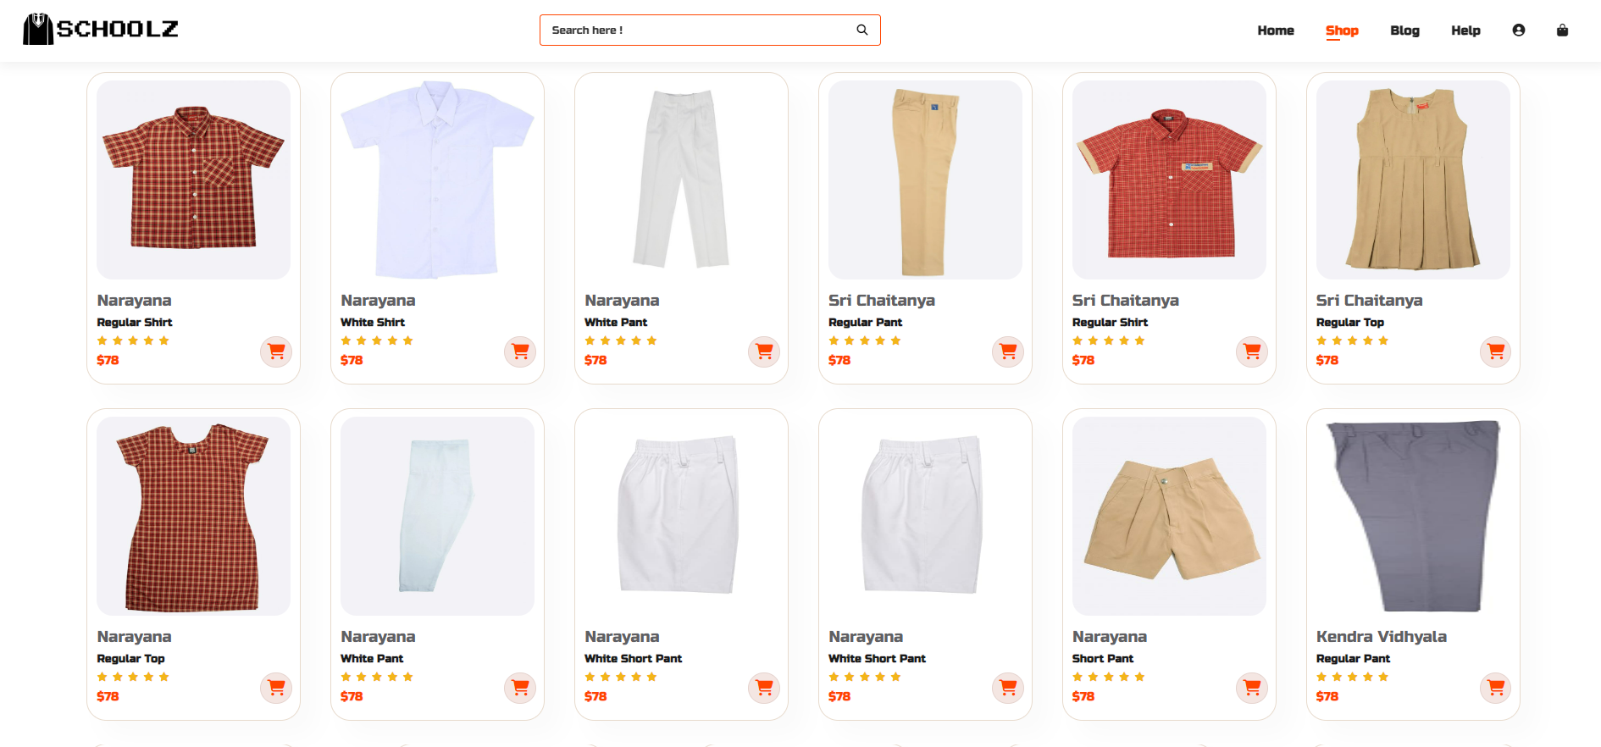

Slide 16
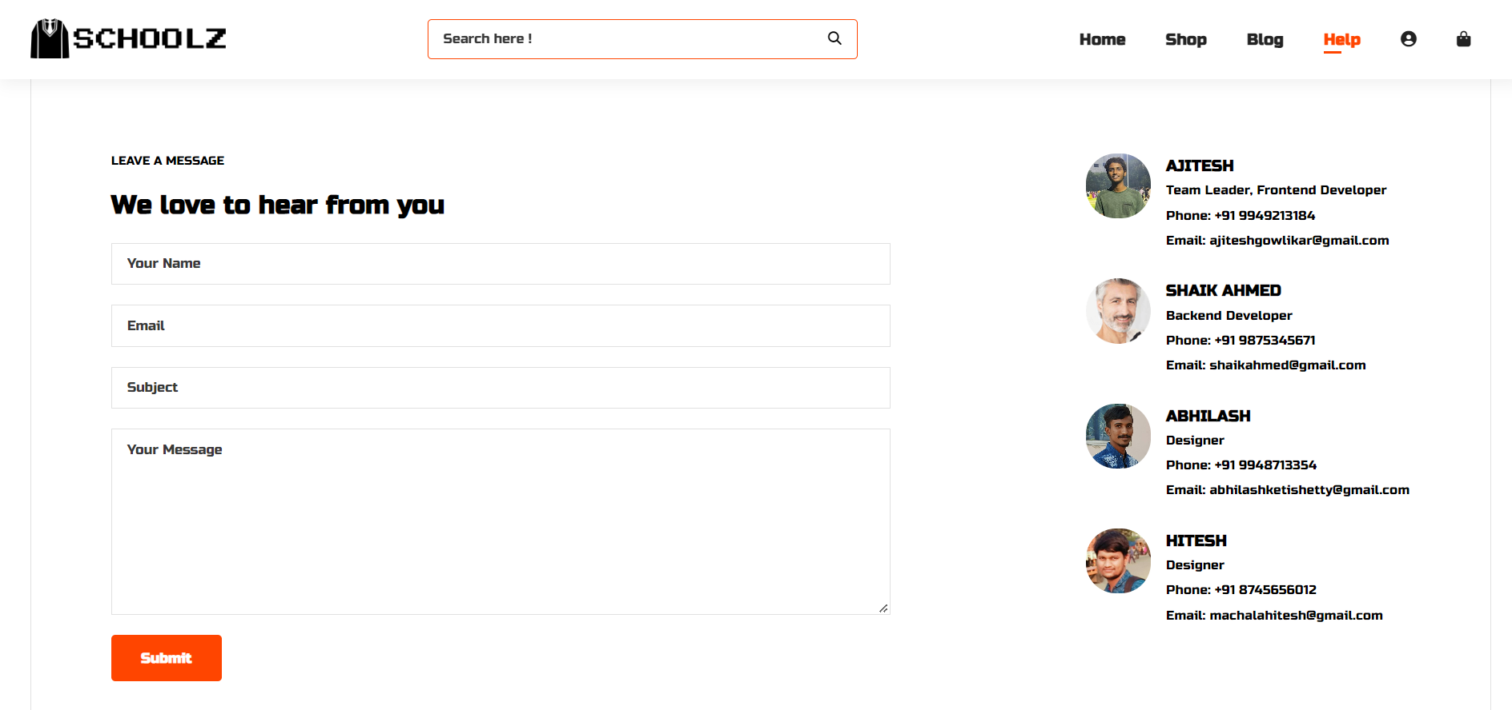

Slide 17
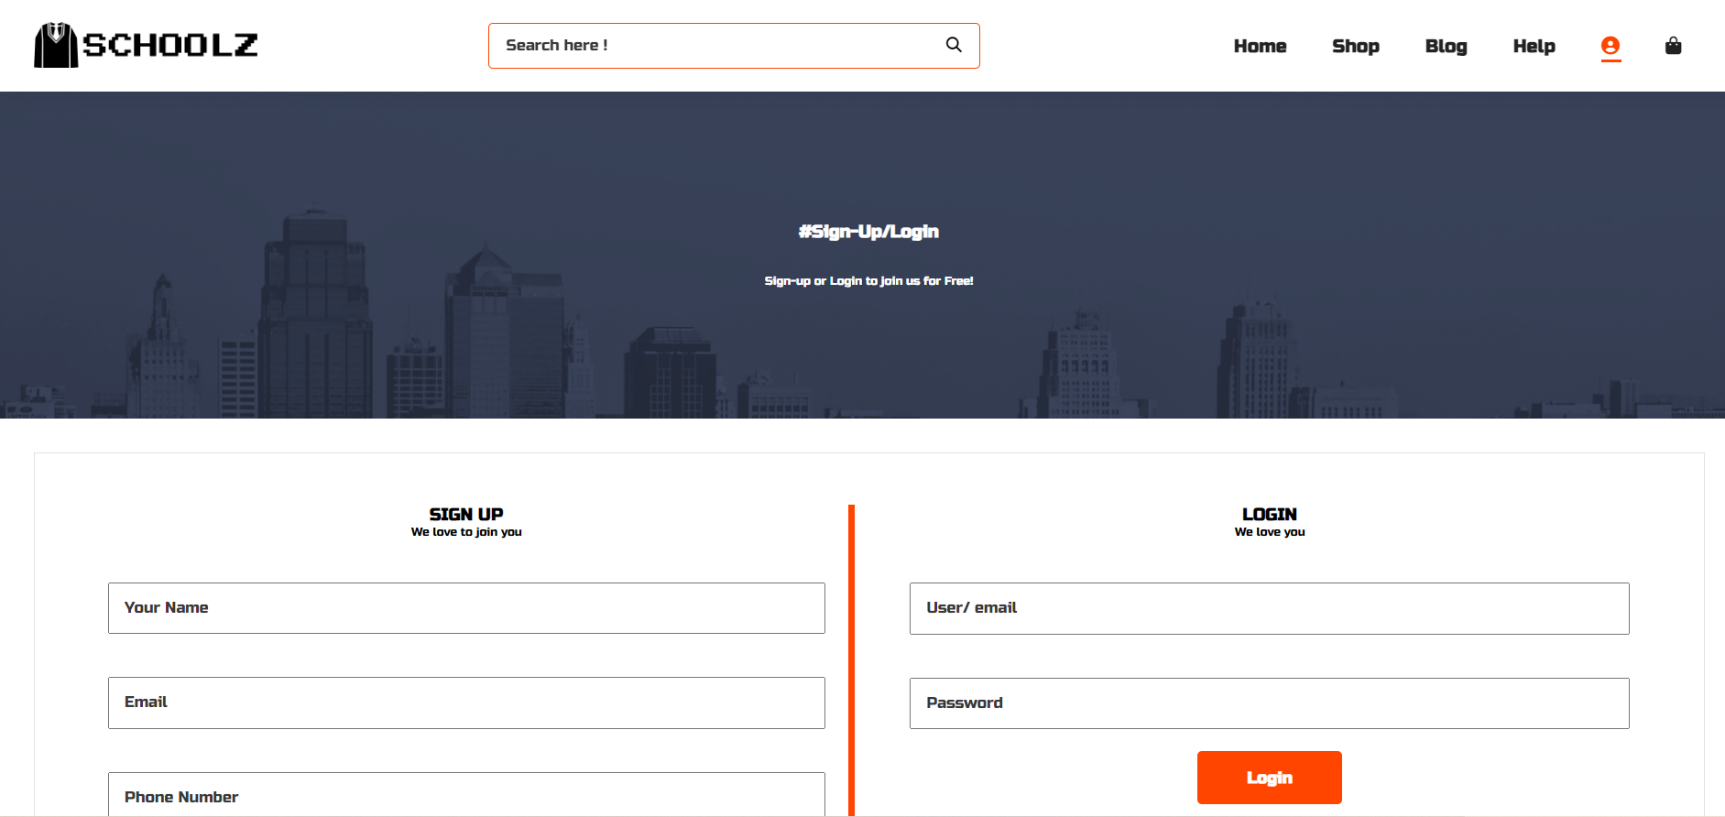

Slide 18
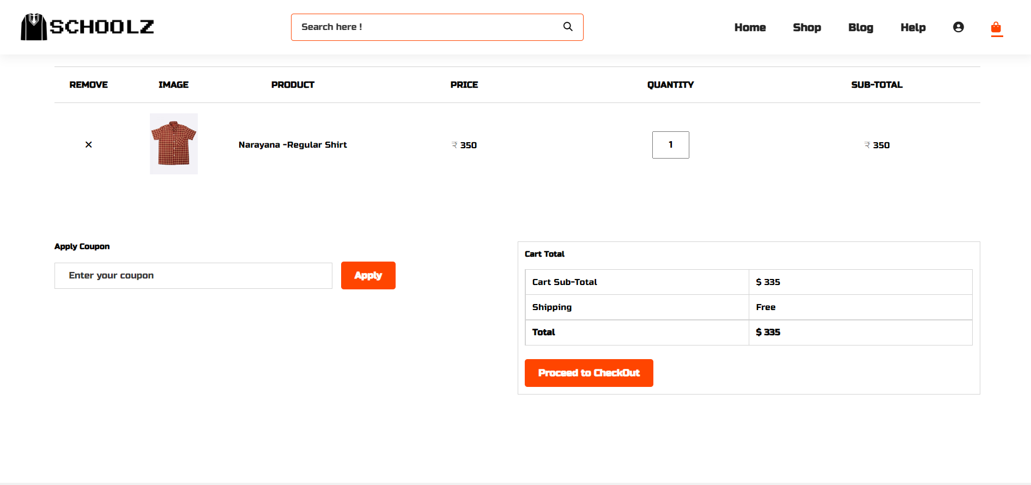

Slide 19


